Slide 1
HHT and TRF in EEG/MEG studies

Slide 2
Install python mackages
https://hackmd.io/@deltaphase/Bkkm0ETJ_
Documentations and datasets
https://emd.readthedocs.io/en/stable/index.html
https://github.com/Eelbrain/Alice

Slide 3
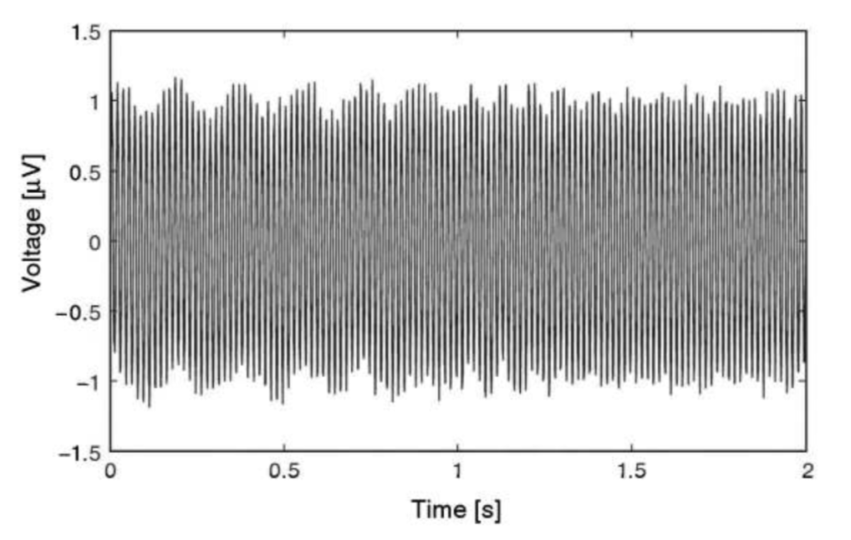
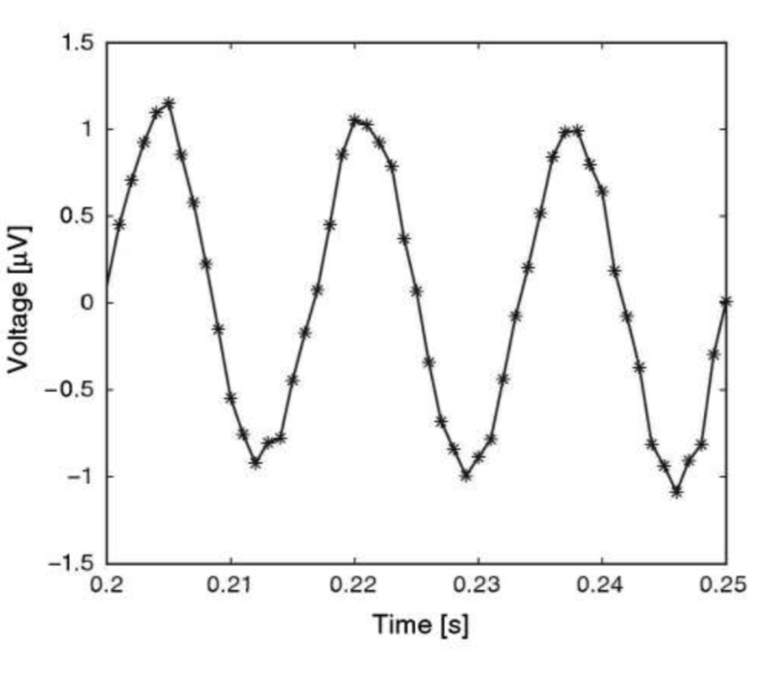
Time domain
X axis: times
Y Axis: amplitude
0.0166s (~60Hz)

Slide 4
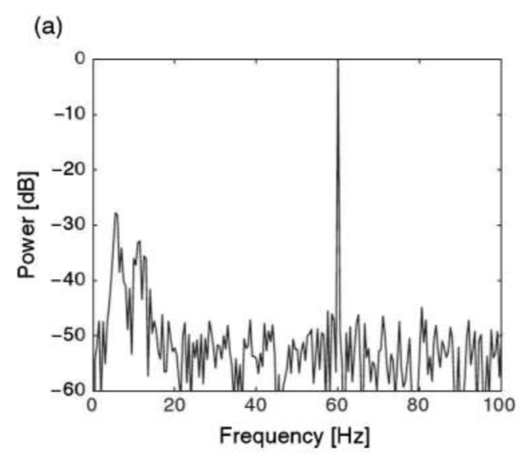
From time domain to frequency domain
Time domain: ranges of x axis is defined by duration of EEG recording
Frequency domain: ranges of x axis is defined by sampling frequency

Slide 5
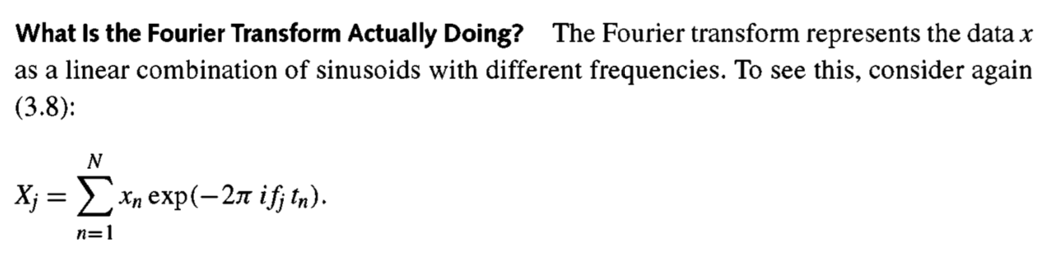

Fourier Transform
summing up the data over the entire time of recording

Slide 6
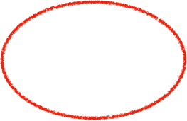
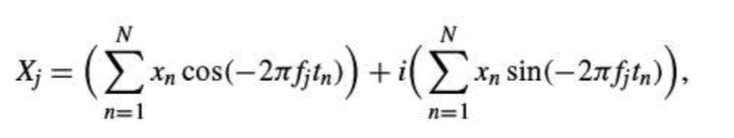
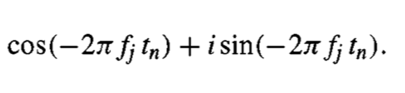
Fourier Transform
(Euler’s formula)

Slide 7
Fourier Transform
The second term of this equation is like the first, except we multiply the data X_{n} by a sine function.

Slide 8
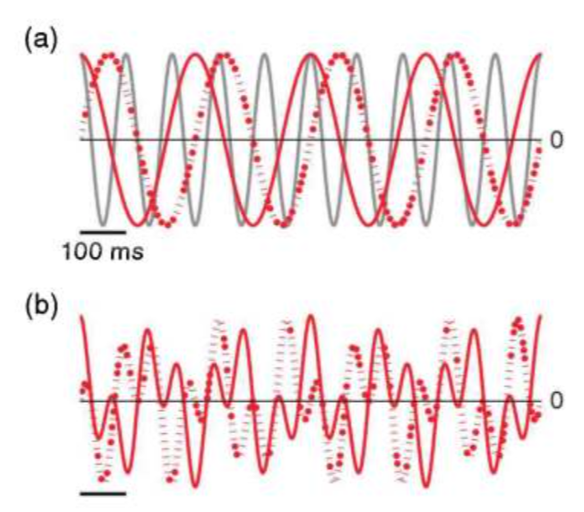
Fourier Transform
When the data and sinusoid at frequency fj do not align, the summation in the Fourier transform is small and Xj is a tiny number.
Signal (10 Hz)
cosine (4 Hz)
Signal (10 Hz) * cosine (4 Hz)
sine (4 Hz)
Signal (10 Hz) * sine (4 Hz)

Slide 9
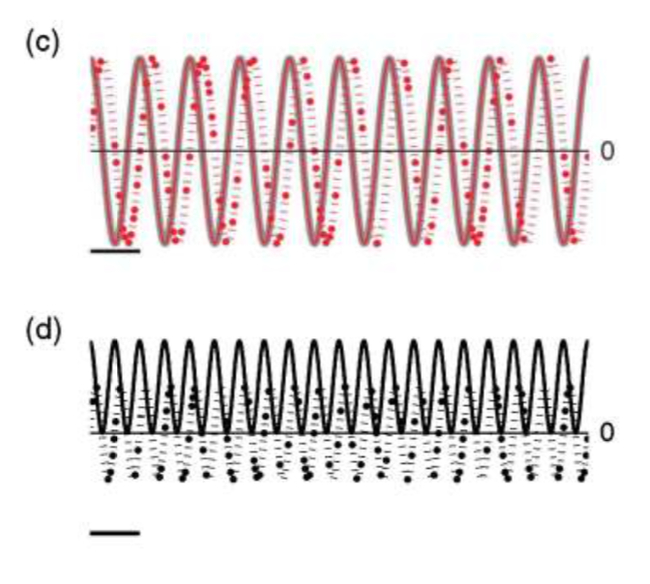
Fourier Transform
When the data and sinusoid at frequency fj align the summation in the Fourier transform is large and the result Xj is a large number.
Signal (10 Hz)
Signal (10 Hz) * cosine (10 Hz)
cosine (10 Hz)
Signal (10 Hz) * sine (10 Hz)
sine (10 Hz)

Slide 10
• Hilbert-Huang transform：
EMPIRICAL MODE DECOMPOSITION
1. 先將一個信號分成多個 Intrinsic Mode Function (IMF) + trend
和 Fourier analysis 不同的地方在於，IMF 的 period 和 amplitude 可以不 固定
2. 運用 Hilbert transform 分析每個 components 的 instantaneous frequency

Slide 11
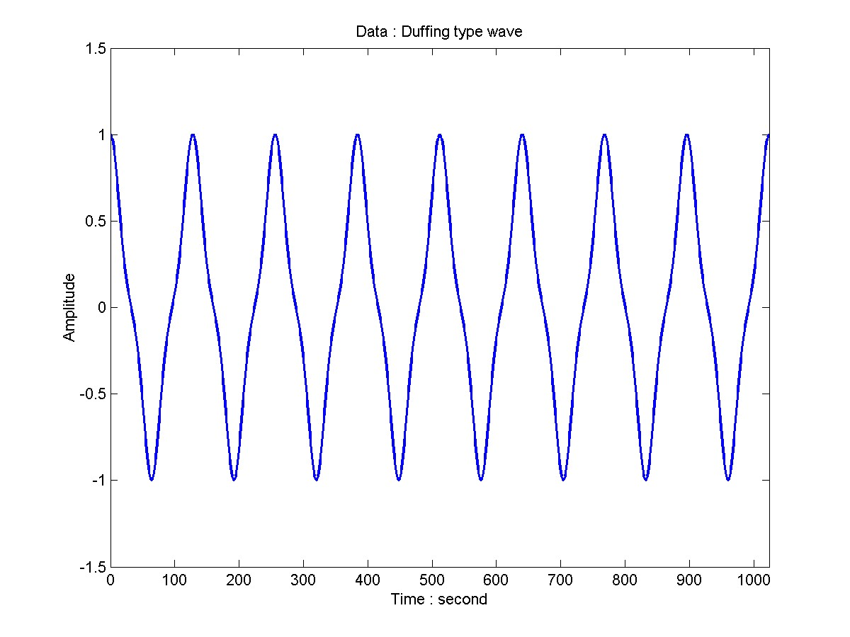
Duffing Type Wave Data: x = cos(wt+0.3 sin2wt)

Slide 12
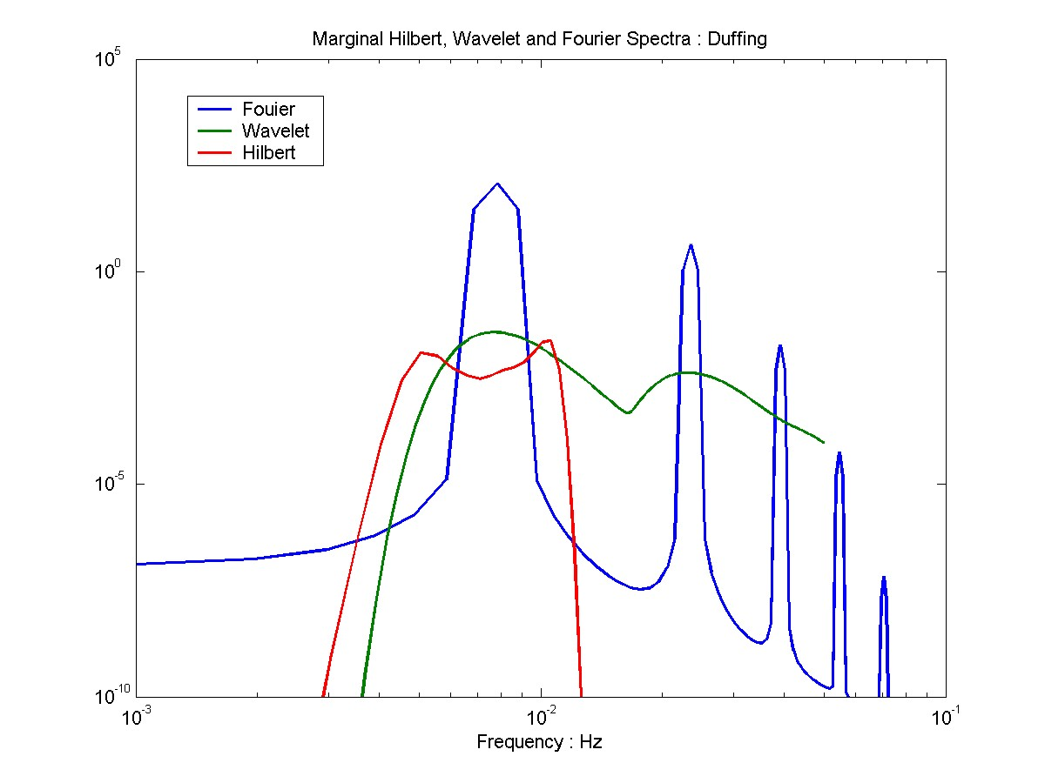
Duffing Type Wave, Marginal Spectra Data: x = cos(wt+0.3 sin2wt)

Slide 13
Hilbert-Huang Transformation
HHT beta: Hilbert transfer
HHT 1.0: EMD (Huang et al., 1998)
HHT 2.0: EEMD (Huang et al., 2009)
Holo-Helbert spectrum analysis (Huang et al., 2016)

Slide 14
Single-trial based HHT analysis
IMFs at Cz
(t. by IMFs)
Hilbert spectral analysis
HHT spectrum of IMFs (freq. by times)
trials
(times by channels)
IMFs at Fz
(t. by IMFs)
Hilbert spectral analysis
HHT spectrum of IMFs (freq. by times)
EEMD
・・・・
・・・・
EEMD

Slide 15
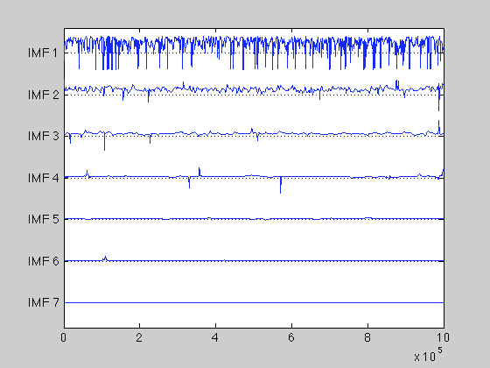
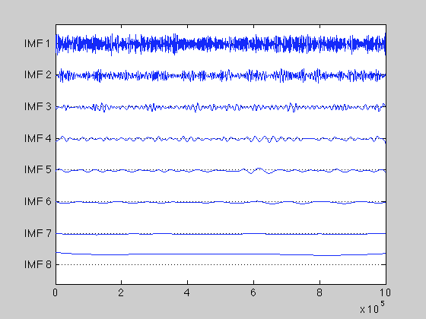
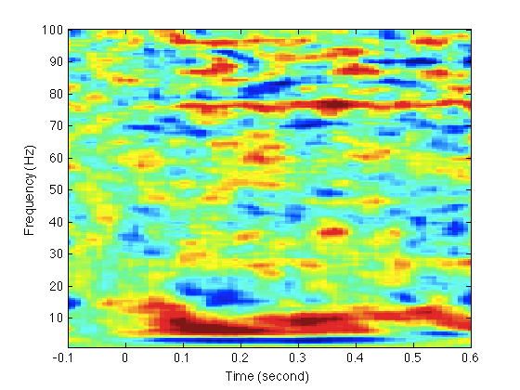
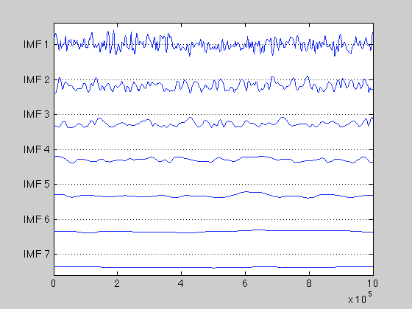
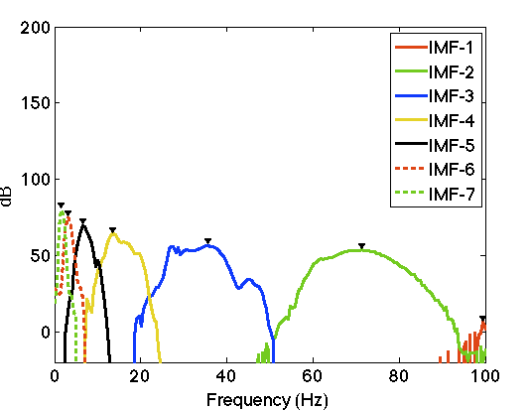
instantaneous frequency
IMF
instantaneous amplitude

Slide 16
Applications of HHT
HHT spectrum analysis
Using IMFs based on the frequency activity (e.g., 2–8.5 Hz) to get “filtered” ERPs

Slide 17
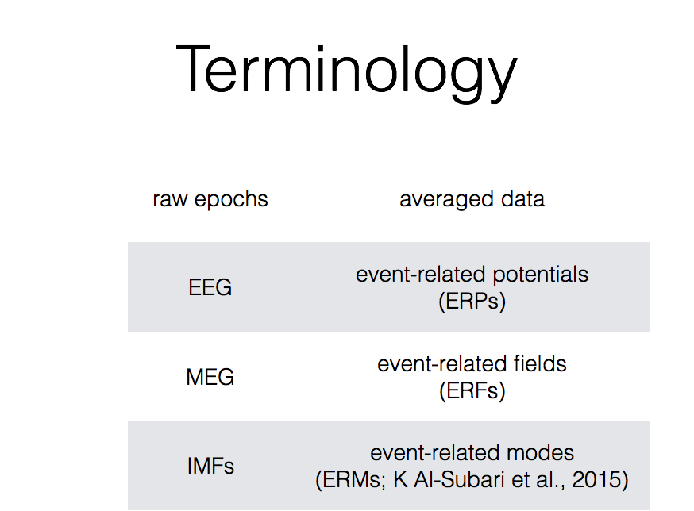

Slide 18
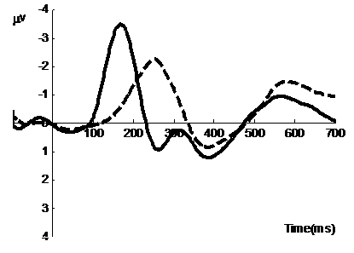
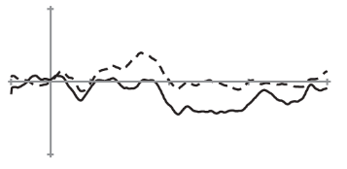
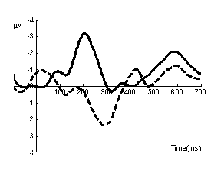
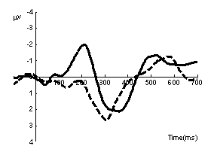
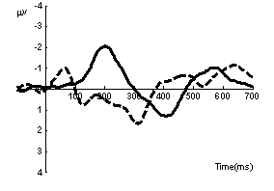
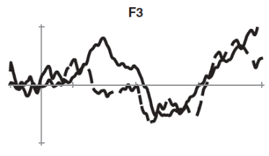
Lexical tone MMN: from newborns to adults
Adults
 | Lexical tone
Standard (80%) | T3: /yi3/
Large Deviant (10%) | T1: /yi1/
Small Deviant (10%) | T2: /yi2/
Large deviant (T1/T3)
Small deviant (T2/T3)
Newborns (< 13 days)
Adult-like MMN
4 yrs
5 yrs
6 yrs
(Cheng et al., 2013; Lee et al., 2012)
P-MMR
6 months
Notes:
So, we adopted the multiple deviant oddball paradigm, and assign the third tone yi3 as the standard, first tone as the large deviant, and the second tone as the small deviant.
Data from awake 6-month-old infants: the large deviant starts to show an adult-like MMN while the small deviant revealed a P-MMR.
children with or without dyslexia. Results demonstrated that the age-matched control
group showed a significantly enhanced MMN to the across-category deviants
compared with the within-category deviants, whereas children with dyslexia did not
show such effects. The enhanced MMN elicited by across-category tonal contrast
indicate that 10-year-old typically developing Mandarin-speaking children have
formed phonological representations of lexical tones similar to adults. Lee et al. (2012)
measured the MMN to Mandarin lexical tones, initial consonants, and vowels in 4- to
6-year-old preschoolers in the two-deviant oddball paradigm to investigate how age,
phonological saliency, and deviance size affect the presence of MMN and p-MMR.
Results showed that for the compulsory elements of Mandarin syllables, i.e. lexical
tones and vowels, the larger deviants elicited adult-like MMNs while the smaller
deviants elicited p-MMRs. The optional elements of the Mandarin syllables, the initial
consonant, only elicited p-MMR in preschoolers. The data suggest that the transition
from p-MMR to adult-like MMN provides information on whether speech perception
in children becomes mature and automatic

Slide 19
Original ERP
Time (ms)
ERM1
ERM1
Time (ms)
Frequency (Hz)
ERM2
ERM2
Time (ms)
Frequency (Hz)
ERM3
ERM3
Amplitudes of Marginal Spectrum (∑ µV)
Time (ms)
Frequency (Hz)
ERM4
Amplitude (µV)
ERM4
ERM5
Time (ms)
Frequency (Hz)
ERM5
ERM6
Time (ms)
Frequency (Hz)
ERM6
ERM7
Time (ms)
Frequency (Hz)
ERM7
Residuals
Time (ms)
Frequency (Hz)
Time (ms)
(Hsu, Lee & Liang, 2016)

Slide 20
Limitation of measuring MMN
Conventional approaches to measuring MMN include recording a large number of trials (e.g., 1000 trials per participant).
To improve the statistical significance of ERP studies, a simple approach is increasing the number of trials. However, this approach prolongs experimental times for recording EEG data and might not be suitable for studying clinical populations and children.

Slide 21
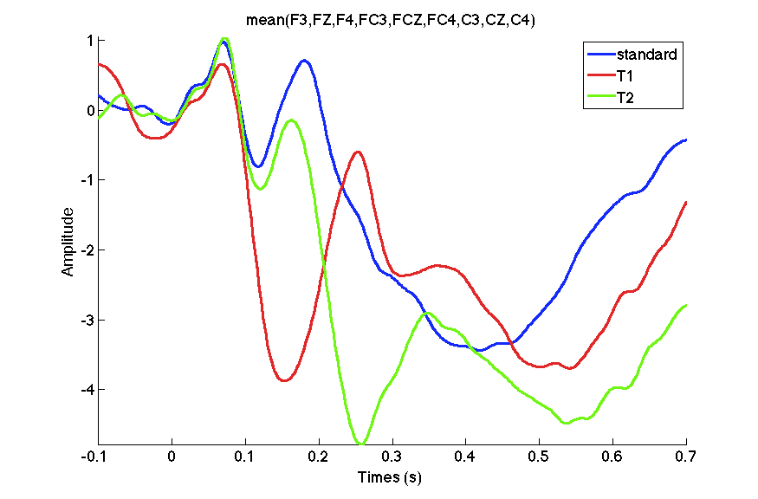
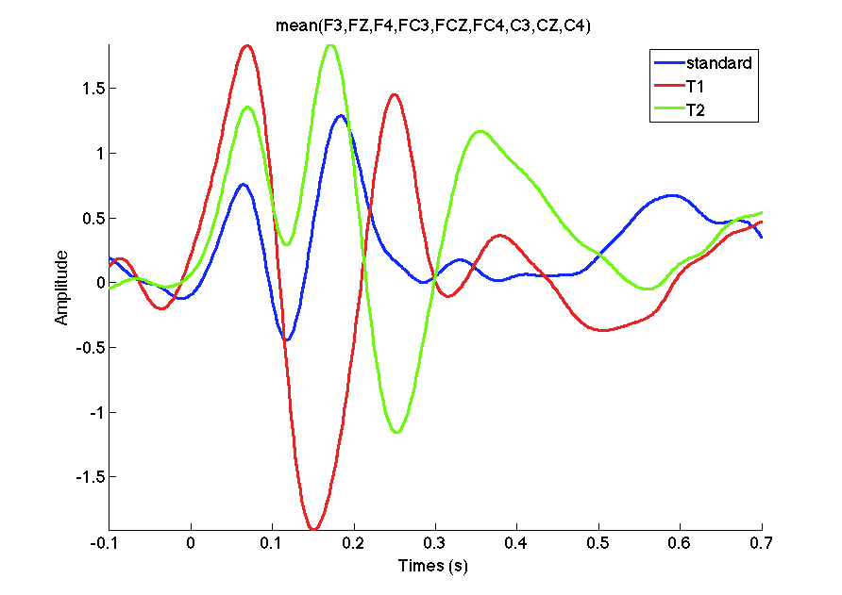
Raw ERPs, 100 ms – 200 ms
IMFs (4 + 5), 100 ms – 200 ms
F(2, 34) = 57.1, p < .001, η = 0.42
F(2, 34) = 75.6, p < .001, η = 0.58
(Hsu, Lee & Liang, 2016)

Slide 22
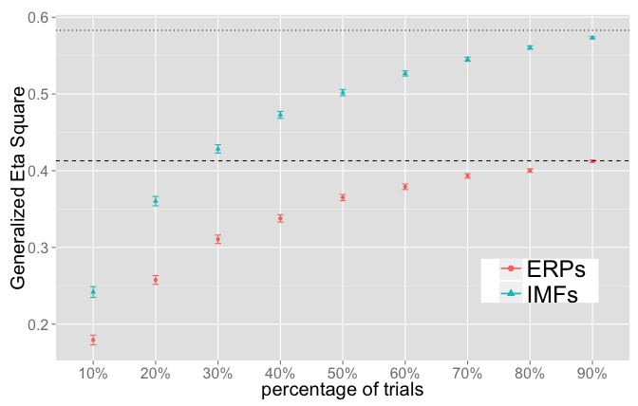
Effect Size of ERPs and IMFs
(Hsu, Lee & Liang, 2016)

Slide 23
Number of participants to replicate MMN effects on ERPs and IMFs
Three levels (p = 3)
repeated-measurements ANOVA: v1 = p-1; v2 = (p-1)(n-1)
α = 0.05, power (1 – β) = 0.8
n = 5
n = 6
n = 9
n = 14
n = 17
(Hsu, Lee & Liang, 2016)

Slide 24
Analytic methods of EEG study
Epoching
Visual Inspection
Continuous waveforms with event marks
Baseline
Artifact
Rejection
Correction
Filtering
Averaging
Epochs aligned to the time-locking events
Averaged waveforms for analysis

Slide 25
Analytic methods of EEG study
Epoching
Visual Inspection
Continuous waveforms with event marks
EMD
spectrums
Remove residuals
and noise components
Epochs aligned to the time-locking events
Averaged waveforms for analysis

Slide 26
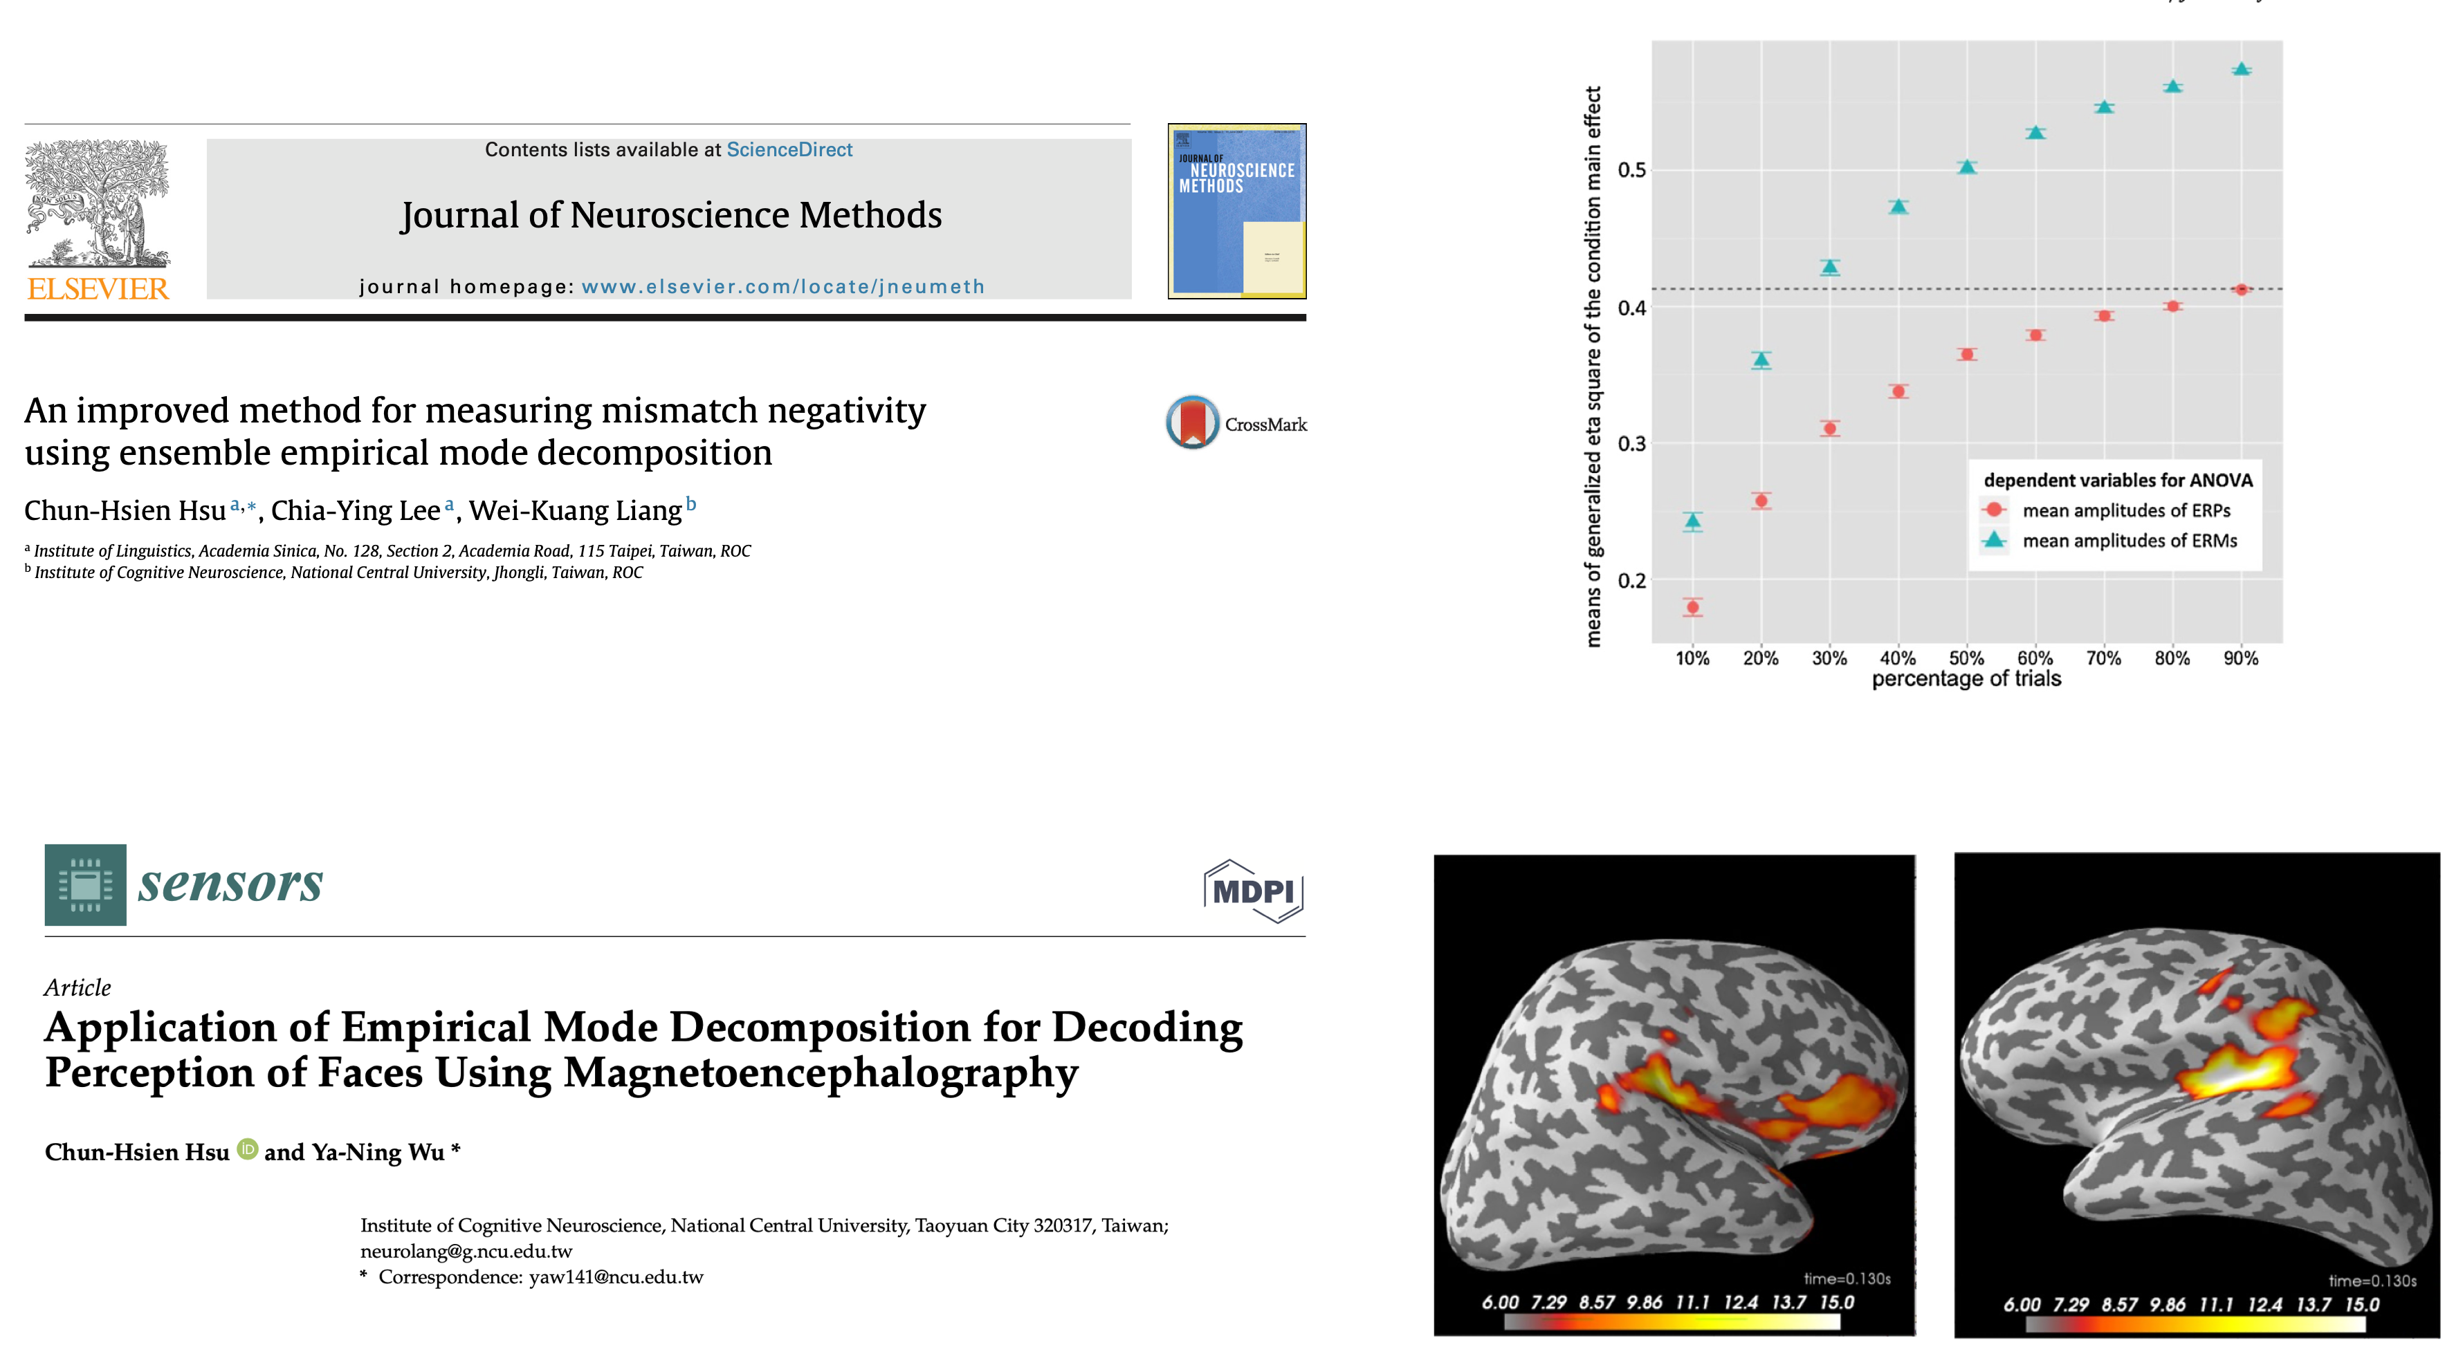

Slide 27
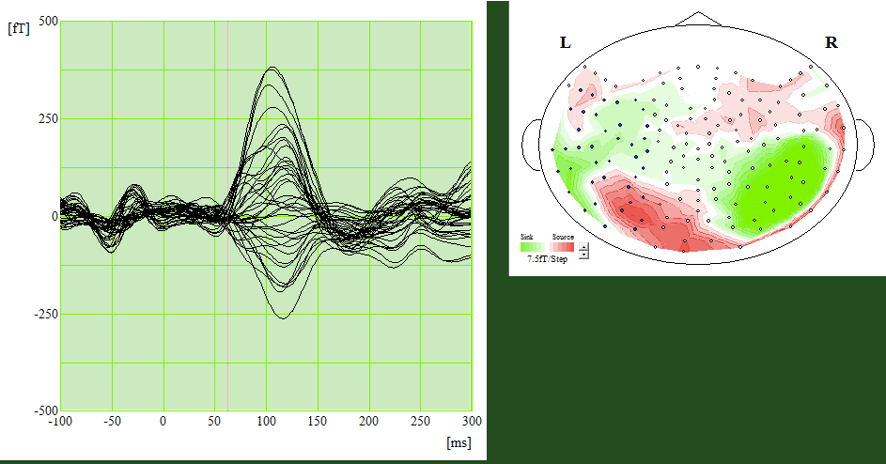
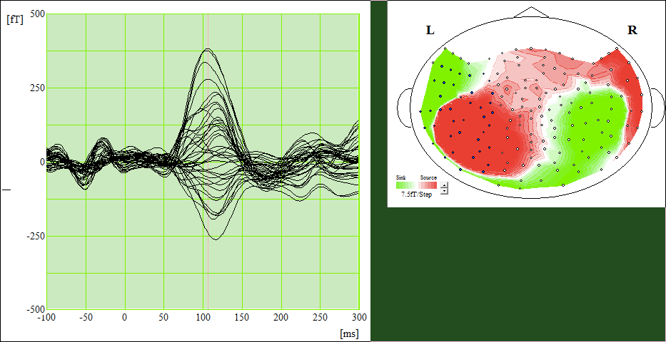

Slide 28
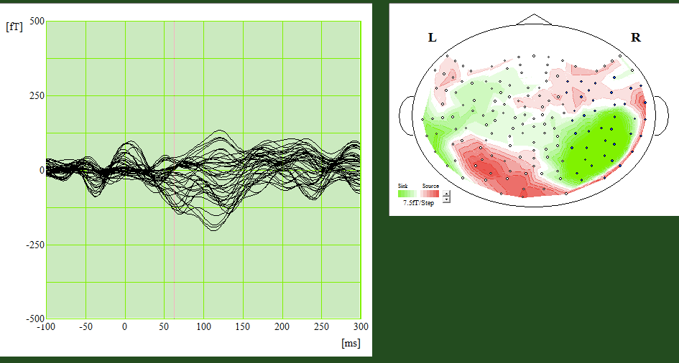
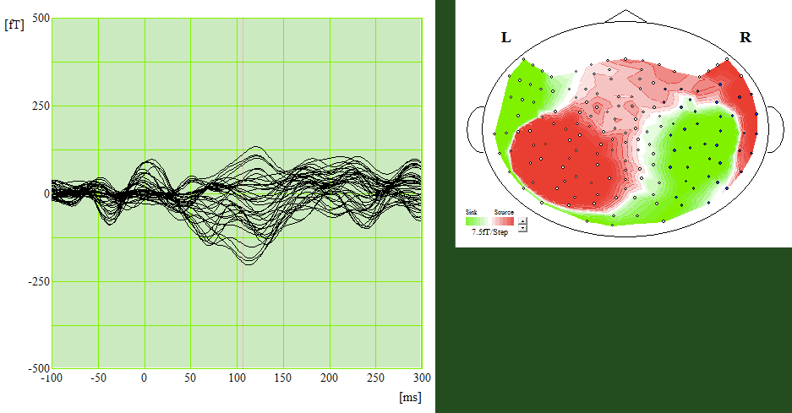

Slide 29
 | IMF4 | IMF5 | IMF6
S001 | 20.202 | 10.101 | 4.0404
S002 | 22.2222 | 10.101 | 4.0404
S003 | 24.2424 | 10.101 | 4.0404
S004 | 22.2222 | 10.101 | 4.0404
S005 | 22.2222 | 10.101 | 4.0404
S006 | 20.202 | 10.101 | 4.0404
S007 | 20.202 | 10.101 | 4.0404
S008 | 20.202 | 10.101 | 4.0404

Slide 30
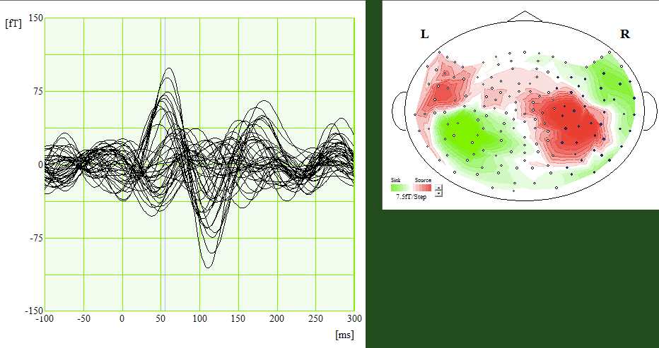
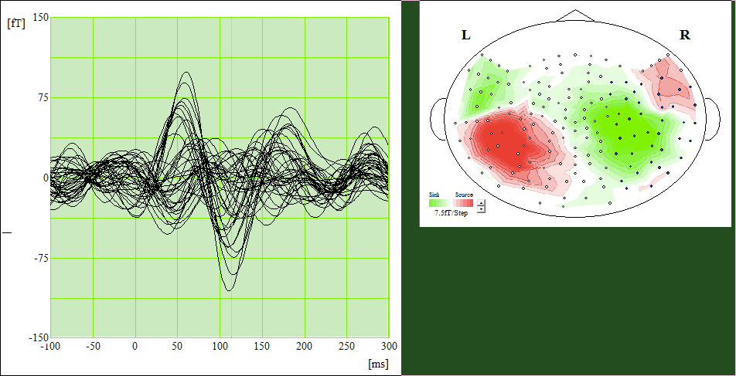

Slide 31
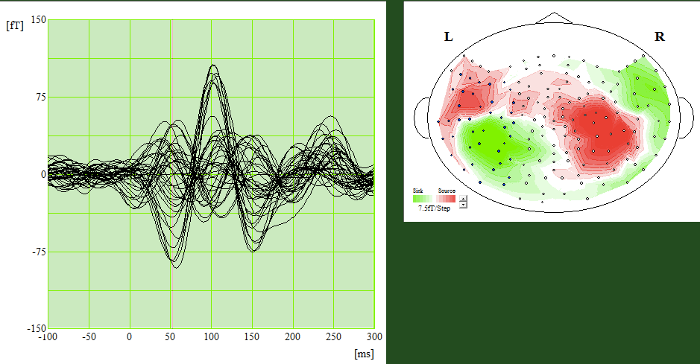
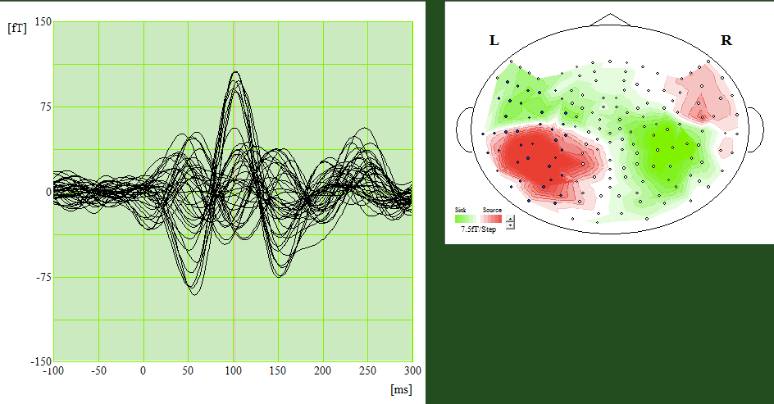

Slide 32
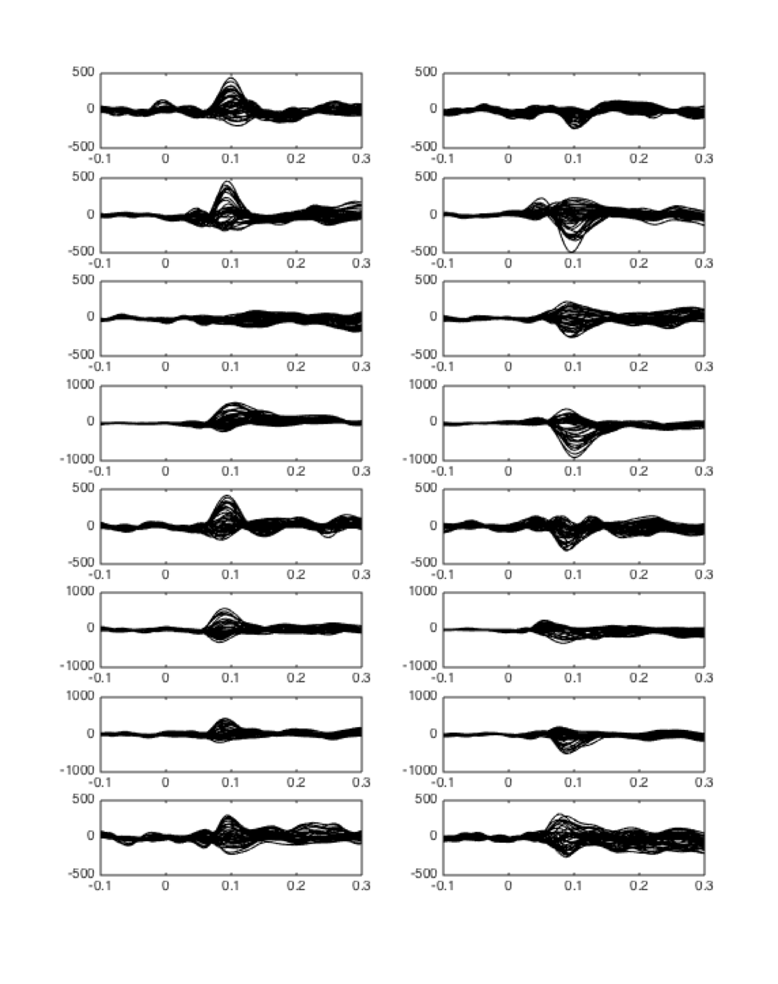
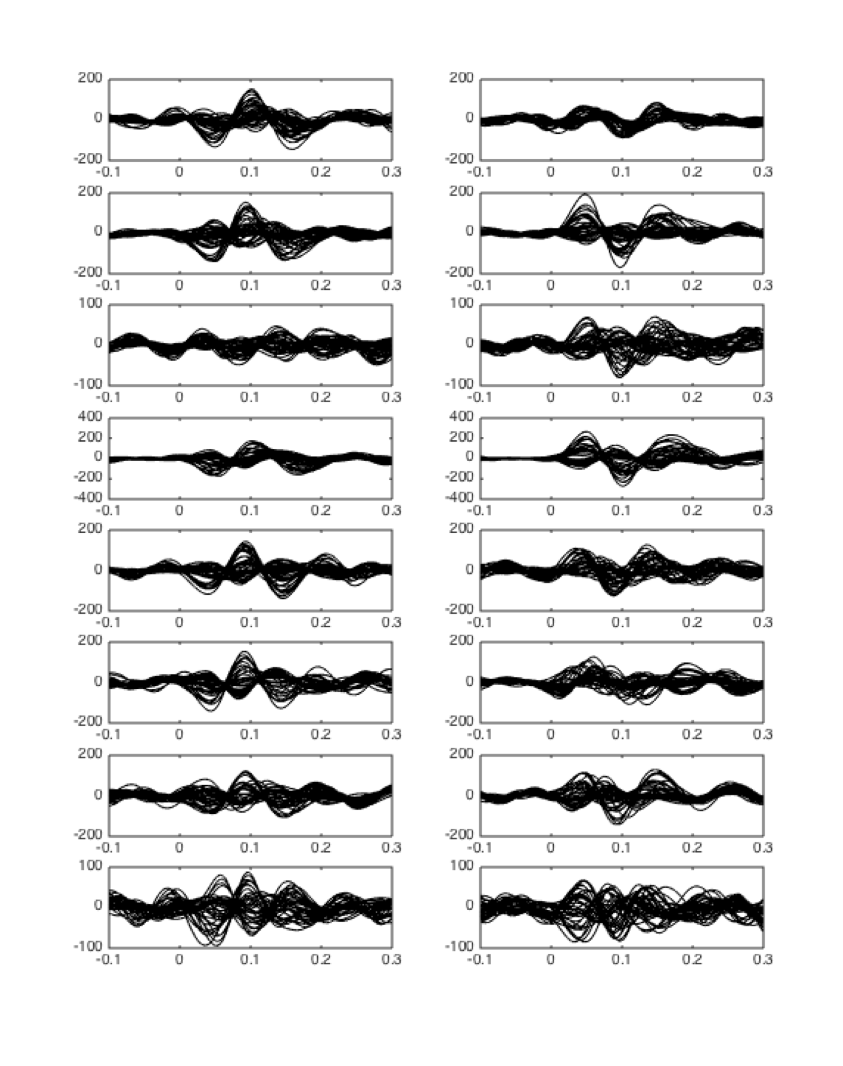
Auditory Evoked Field (conventional method)
Auditory Evoked Field (IMF5 / 10 Hz)
Left Hemisphere
Right Hemisphere
Left Hemisphere
Right Hemisphere
S 001
S 002
S 003
S 004
S 005
S 006
S 007
Amplitude (fT)
S 008
Amplitude (fT)
Times (seconds)
Times (seconds)

Slide 33
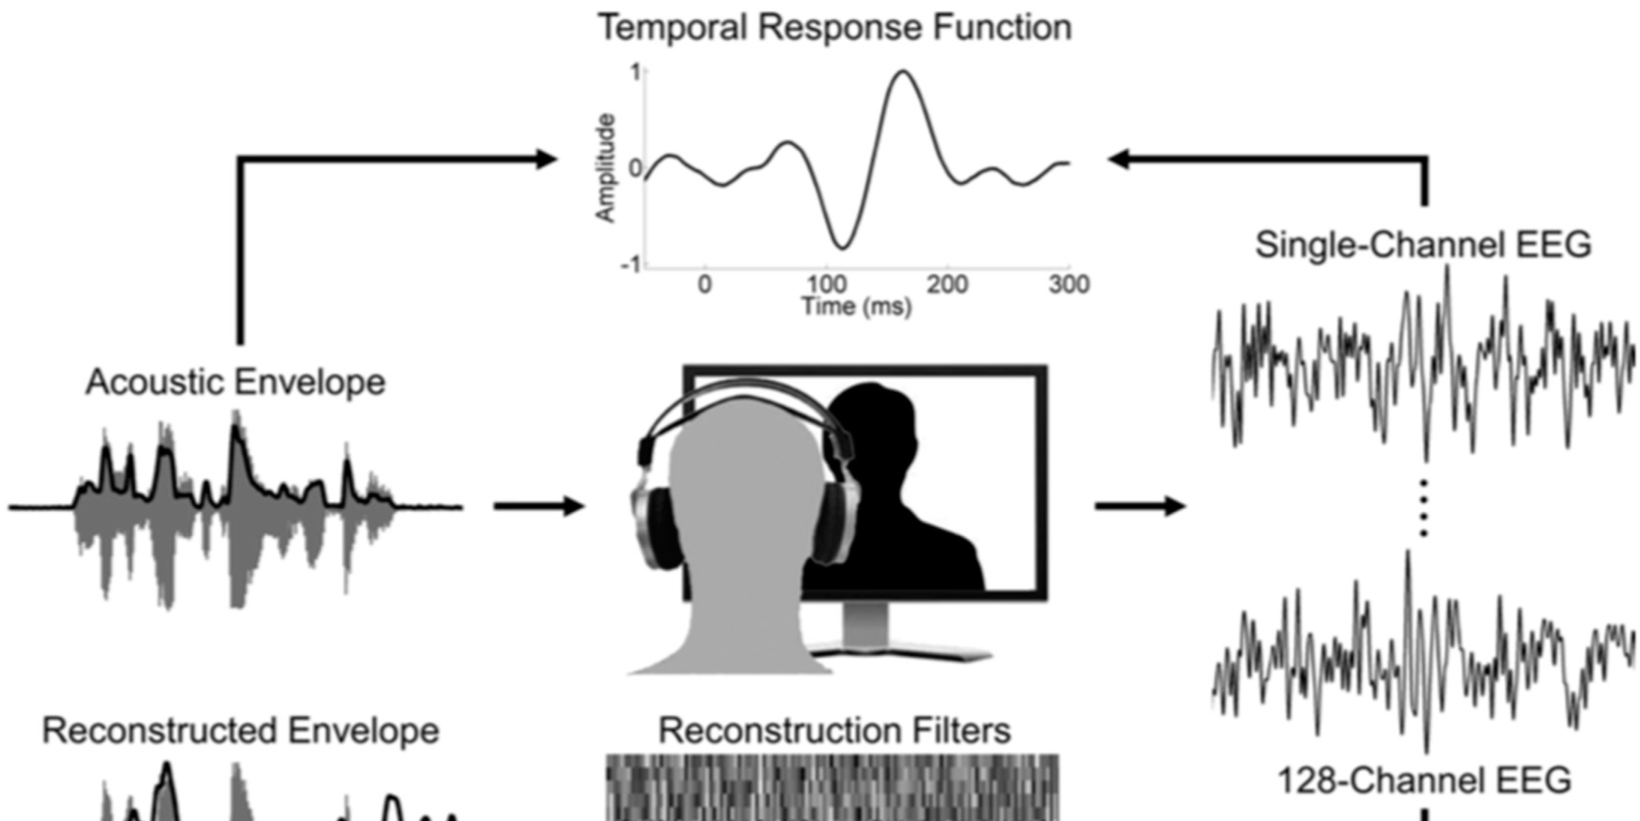
Neural Entrainments (Myers et al., 2019)

Slide 34
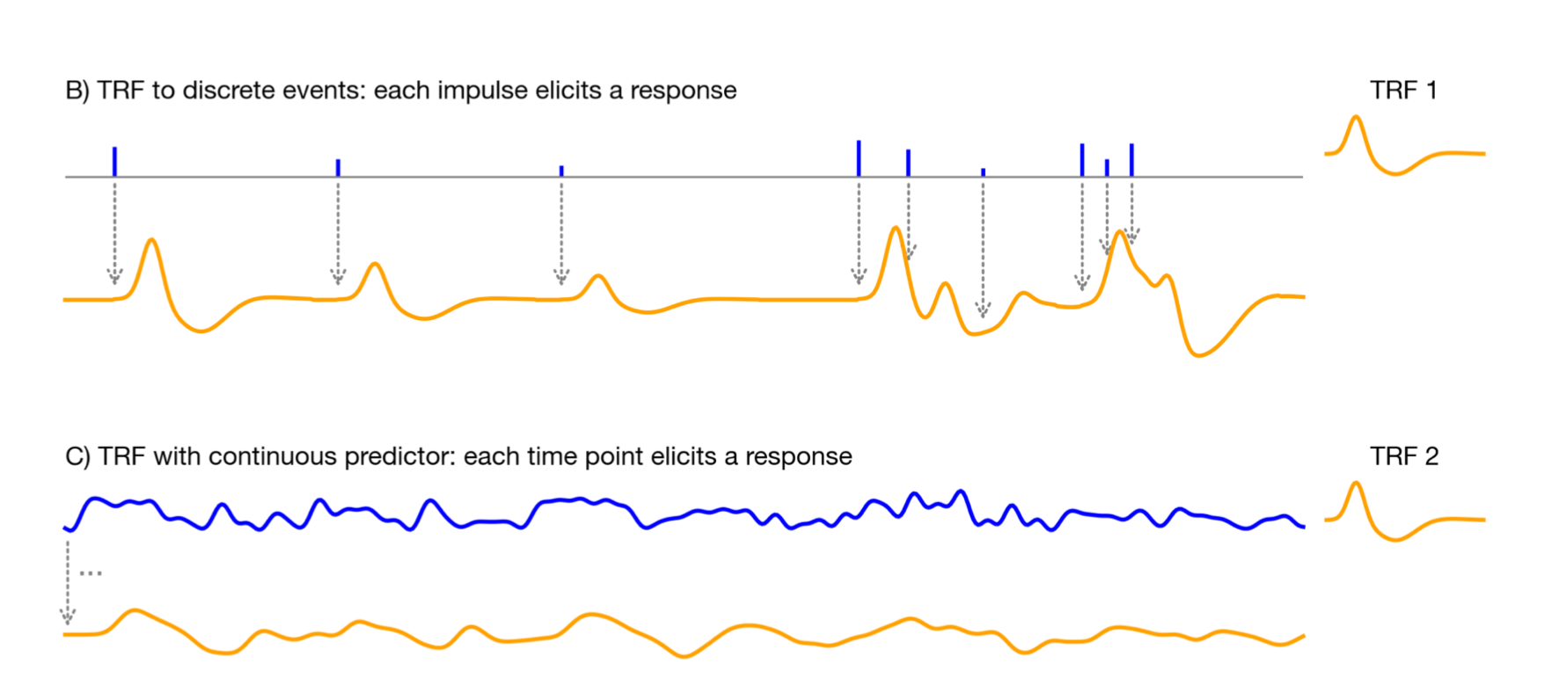
(Brodbeck et al., 2021)

Slide 35
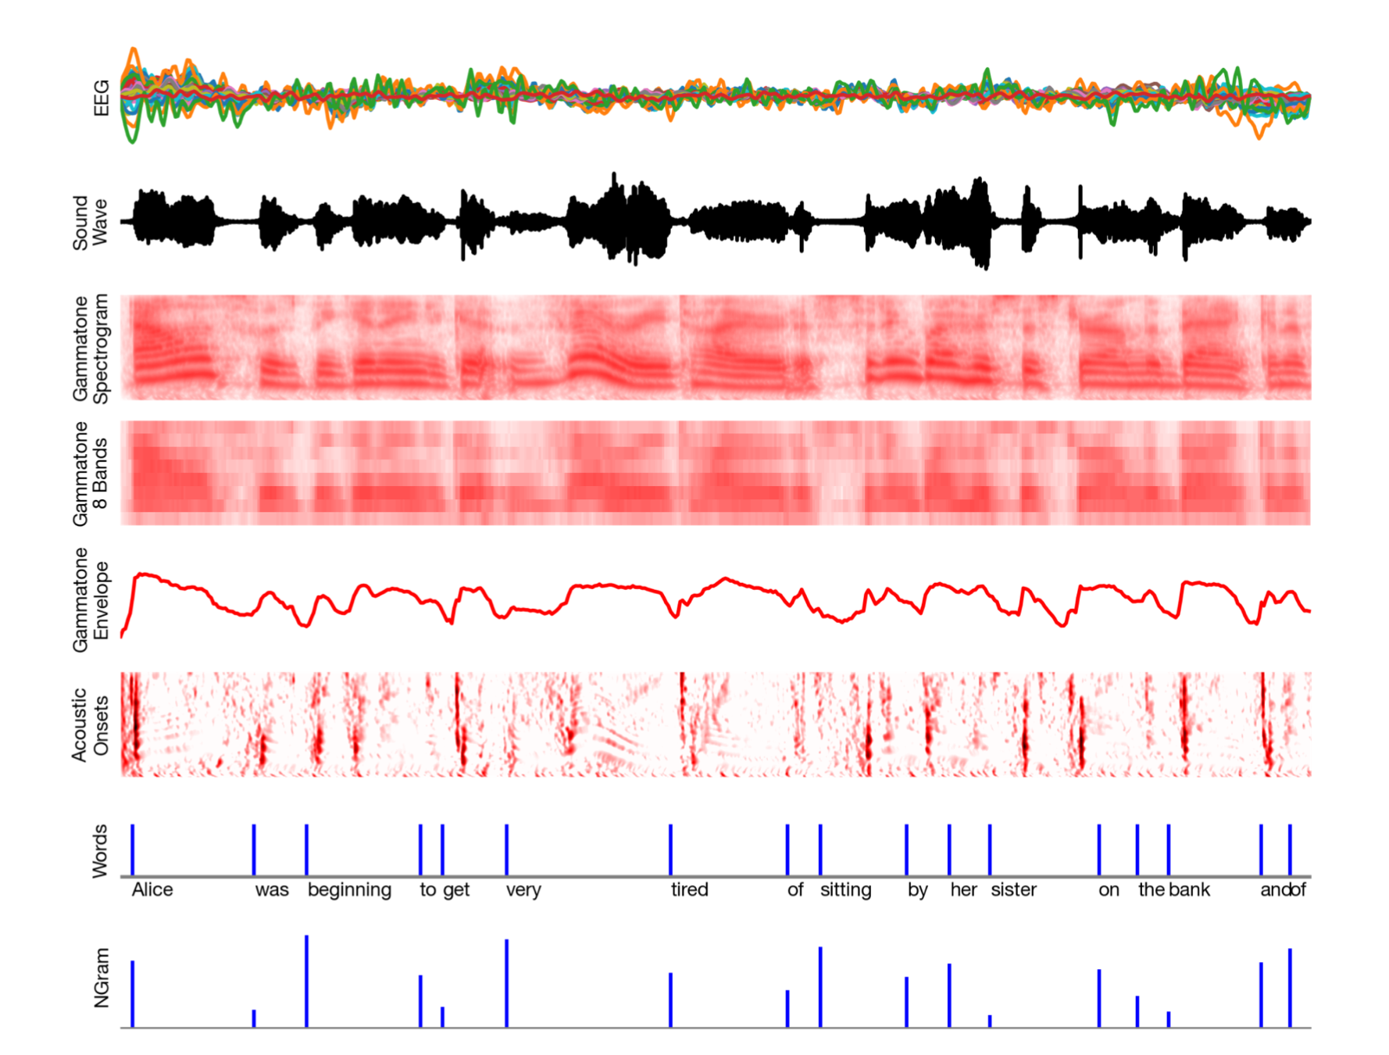
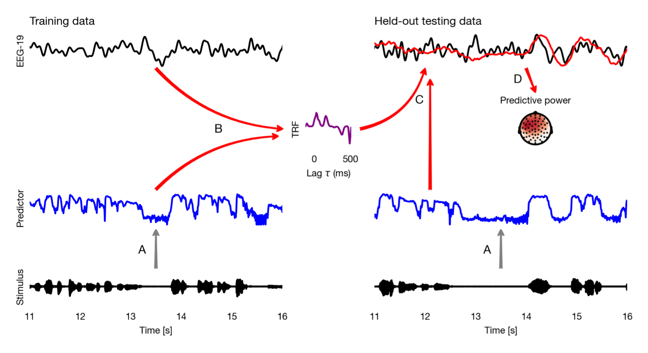
(Brodbeck et al., 2021)

Slide 36
Deconvolution
(Brodbeck et al., 2021)

Slide 37
